Slide 1

ASL detection
Data Mining Project
Xiang Fang
Notes:
American Sign Language detetion

Slide 2
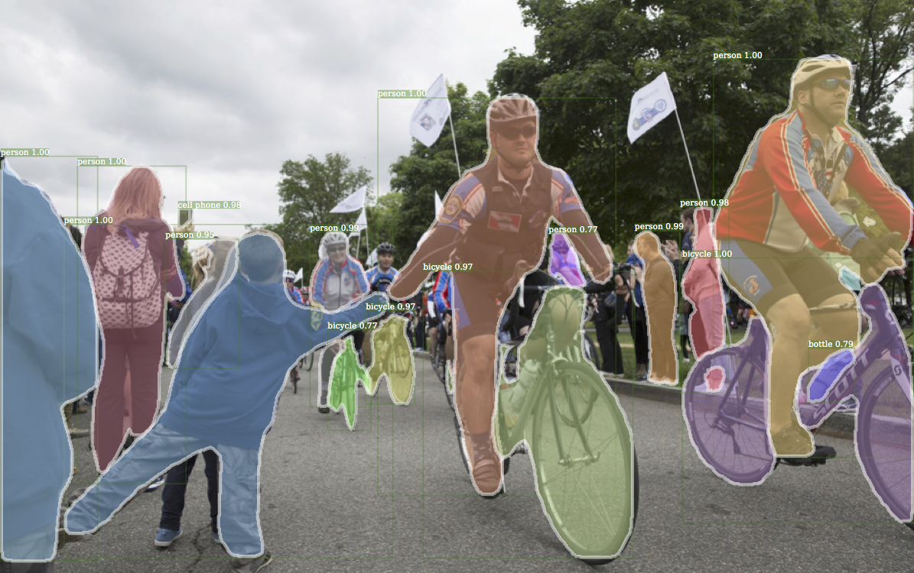

Task: Objection Detection
To detect and locate objects of interest in an image or video. The task involves identifying the position and boundaries of objects in an image, and classifying the objects into different categories.
Notes:
In CV world, classification -> objection detection -> segmentation -> multimodal/generative (My thought)

Slide 3
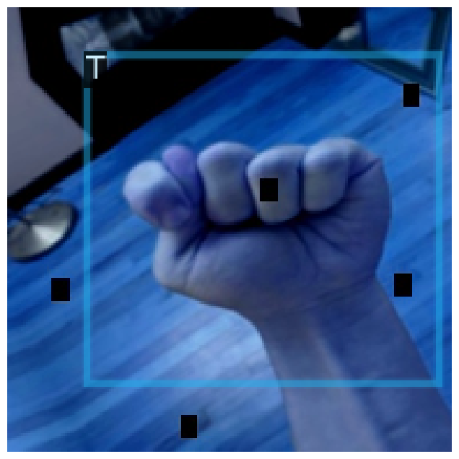
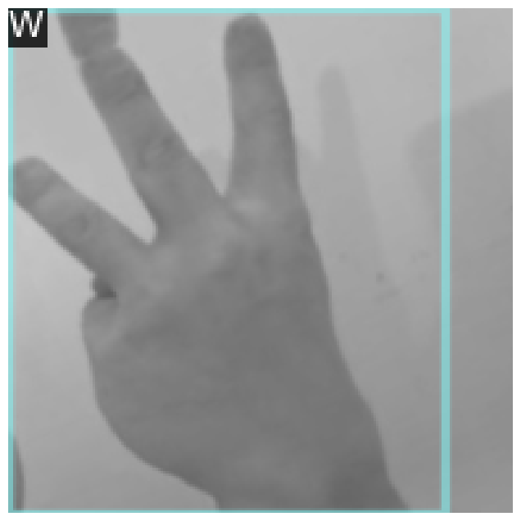
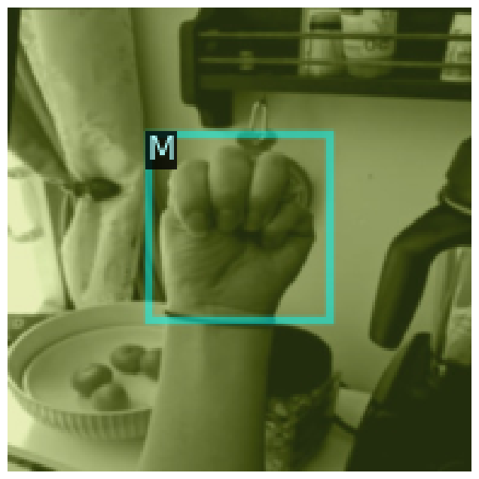
DataSet, Preprocessing, Augmentation
Original images 1728, splitted into train, valid, test 1512, 144, 72, 384x384
Using 20+ ways to augment data to ~10 times, expand training set to 15110, valid set to 2801
Notes:
Those augment methods includes rotation, random size crop, flip, RGB shift, Blur, hueSaturation and so on.
The T picture is augmented by RGBShift(more emphasis on blue), HueSaturationValue(amplify the blue cast), CoarseDropout(the black masks in the pic)
The W picture is augmented by toGray( Converts the image into grayscale, removing color channels.), RandomSizedCrop(cropped a random portion of the image and resized it to 384x384, leading to the object being slightly off-center.)
The M picture is augmented by HueSaturationValue(Likely shifted hue toward the yellow/green spectrum, creating the tint.), RGBShift(emphasizing the green channel.)

Slide 4
Evaluation Metrics: from Precision to mAP 50-95
Average Precision (AP): Area under the precision-recall curve
mean Average Precision (mAP): mean of the AP values across all classes
Intersection over Union (IoU): Overlap between the predicted bbox and the ground truth bbox
mAP 50: mAP computed at a single IoU threshold of 0.50. A detection is considered correct if the IoU ≥ 0.50.
mAP 50-95: mAP averaged over multiple IoU thresholds from 0.50 to 0.95, typically with a step size of 0.05. Primary Metric (Used by COCO dataset)
Notes:
AP measures the precision-recall tradeoff for a specific class.
It is calculated as the area under the precision-recall curve.
The precision-recall curve plots precision (y-axis) against recall (x-axis).
How to calculate AP?
AP is the integral of the precision-recall curve
Since exact integration is computationally expensive, AP is often approximated using 11-point or all-point interpolation:
IoU measures the overlap between the predicted bounding box and the ground truth bounding box.
It is critical for determining whether a detection is a true positive (IoU ≥ threshold) or false positive (IoU < threshold).
Typically, IoU thresholds range from 0.50 to 0.95 to evaluate detection quality.
mAP is the mean of the Average Precision (AP) values across all classes in the dataset.
mAP gives an overall measure of model performance across all classes.
It helps compare object detection models and datasets effectively.
mAP@50 is mAP computed at a single IoU threshold of 0.50.
A detection is considered correct if the IoU ≥ 0.50.
mAP@50:95 is mAP averaged over multiple IoU thresholds from 0.50 to 0.95 (inclusive), with a step size of 0.05. [0.50, 0.55, ..., 0.95].
This is a stricter and more comprehensive metric than mAP@50.
It reflects a model’s ability to detect objects under varying overlap conditions.
The COCO dataset defines mAP@50:95 as the primary metric for object detection benchmarking.

Slide 5
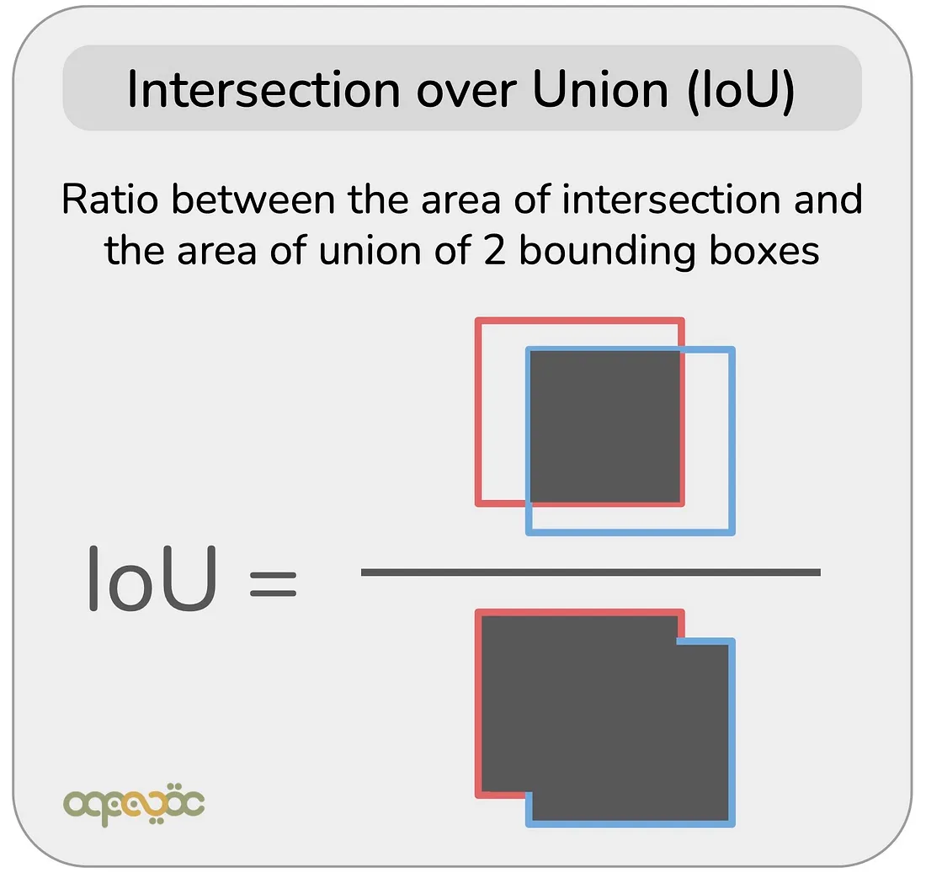
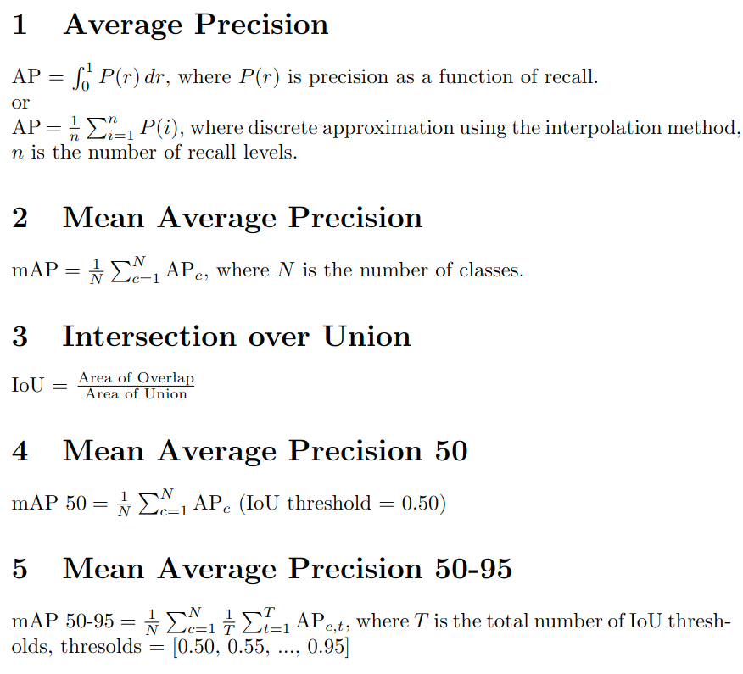
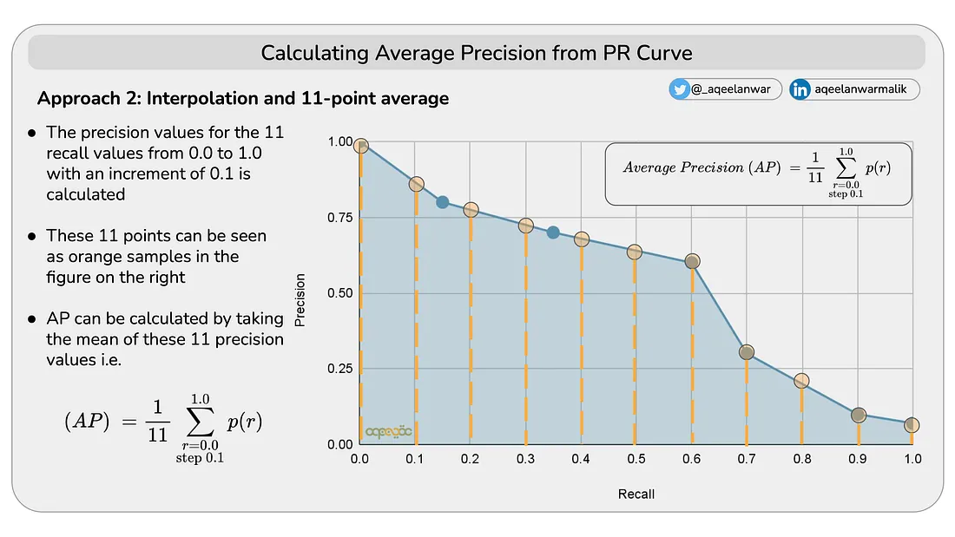
Evaluation Metrics: Formulas
Notes:
AP measures the precision-recall tradeoff for a specific class. AP is NOT the average of precision across the different classes.
It is calculated as the area under the precision-recall curve.
The precision-recall curve plots precision (y-axis) against recall (x-axis).
How to calculate AP?
AP is the integral of the precision-recall curve
Since exact integration is computationally expensive, AP is often approximated using 11-point or all-point interpolation:
IoU measures the overlap between the predicted bounding box and the ground truth bounding box.
It is critical for determining whether a detection is a true positive (IoU ≥ threshold) or false positive (IoU < threshold).
Typically, IoU thresholds range from 0.50 to 0.95 to evaluate detection quality.
mAP is the mean of the Average Precision (AP) values across all classes in the dataset.
mAP gives an overall measure of model performance across all classes.
It helps compare object detection models and datasets effectively.
mAP@50 is mAP computed at a single IoU threshold of 0.50.
A detection is considered correct if the IoU ≥ 0.50.
mAP@50:95 is mAP averaged over multiple IoU thresholds from 0.50 to 0.95 (inclusive), with a step size of 0.05. [0.50, 0.55, ..., 0.95].
This is a stricter and more comprehensive metric than mAP@50.
It reflects a model’s ability to detect objects under varying overlap conditions.
The COCO dataset defines mAP@50:95 as the primary metric for object detection benchmarking.

Slide 6
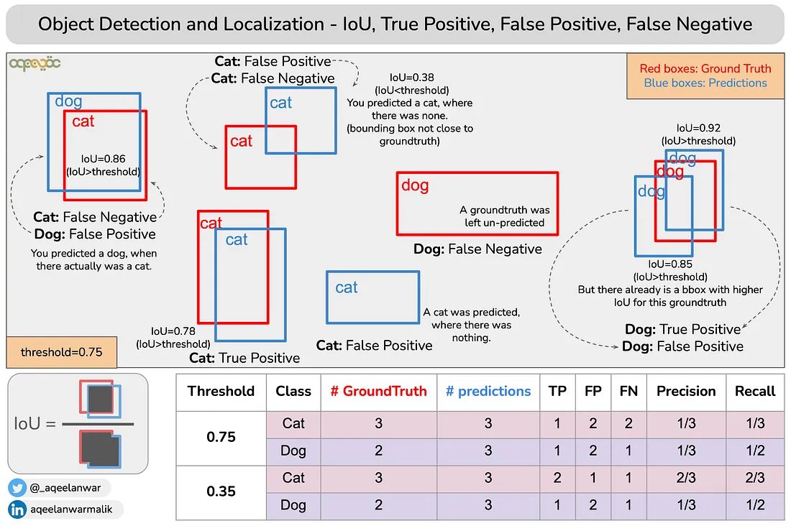
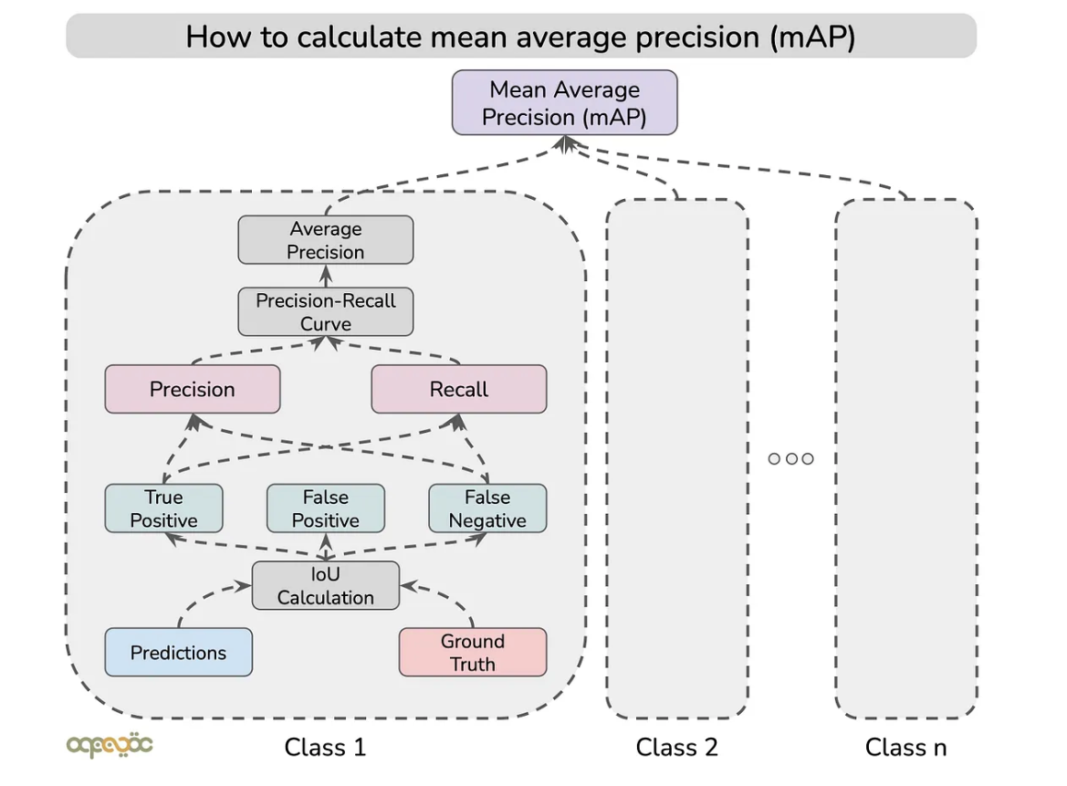
Evaluation Metrics: mAP 50-95
Notes:
AP measures the precision-recall tradeoff for a specific class.
It is calculated as the area under the precision-recall curve.
The precision-recall curve plots precision (y-axis) against recall (x-axis).
How to calculate AP?
AP is the integral of the precision-recall curve
Since exact integration is computationally expensive, AP is often approximated using 11-point or all-point interpolation:
IoU measures the overlap between the predicted bounding box and the ground truth bounding box.
It is critical for determining whether a detection is a true positive (IoU ≥ threshold) or false positive (IoU < threshold).
Typically, IoU thresholds range from 0.50 to 0.95 to evaluate detection quality.
mAP is the mean of the Average Precision (AP) values across all classes in the dataset.
mAP gives an overall measure of model performance across all classes.
It helps compare object detection models and datasets effectively.
mAP@50 is mAP computed at a single IoU threshold of 0.50.
A detection is considered correct if the IoU ≥ 0.50.
mAP@50:95 is mAP averaged over multiple IoU thresholds from 0.50 to 0.95 (inclusive), with a step size of 0.05. [0.50, 0.55, ..., 0.95].
This is a stricter and more comprehensive metric than mAP@50.
It reflects a model’s ability to detect objects under varying overlap conditions.
The COCO dataset defines mAP@50:95 as the primary metric for object detection benchmarking.

Slide 7
Terms: Anchor Based vs Anchor Free
Terms: One-Stage vs. Two-Stage
Anchor Based: predefined bounding boxes and then adjust anchors to fit (faster RCNN, YOLOv3v4)
Anchor Free: directly predicts object centers or key points and then generates the bounding box using offsets or regressions. (YOLOv8 and most models afterwards)
One-Stage: directly predict bounding boxes and classes. (YOLO)
Two-Stage: Split detection into two stages, 1. Region Proposal Network (RPN) generates proposals and 2. Classifier and regressor refine proposals.
(faster R-CNN)
Notes:
Anchor-Based Object Detection:
Definition: Uses predefined bounding boxes (anchors) of various sizes and aspect ratios placed across the image grid.
How it Works:
Each anchor is matched to the closest ground truth object based on overlap (e.g., IoU).
The model predicts adjustments to these anchors to better fit the objects.
Advantages: Handles objects of varying scales effectively.
Disadvantages: Computationally expensive due to the large number of anchor boxes.
Anchor-Free Object Detection:
Definition: Directly predicts object centers or key points instead of relying on predefined anchors.
How it Works:
The model predicts the center of an object and generates the bounding box using offsets or regressions.
Advantages: Simplifies detection, faster computation.
Disadvantages: May struggle with extreme aspect ratios or small objects.
One-Stage Detectors:
Key Idea: Combine region proposal and classification in a single step.
Directly predicts bounding box coordinates and class probabilities from feature maps.
Example: YOLO, RetinaNet.
Advantages:
Fast and suitable for real-time applications.
Simplified architecture.
Two-Stage Detectors:
Key Idea: Split detection into two stages:
Stage 1: Region Proposal Network (RPN) generates proposals.
Stage 2: Classifier and regressor refine proposals.
Example: Faster R-CNN, Mask R-CNN.
Advantages:
High accuracy for detecting small and overlapping objects.
Modular and flexible design.

Slide 8
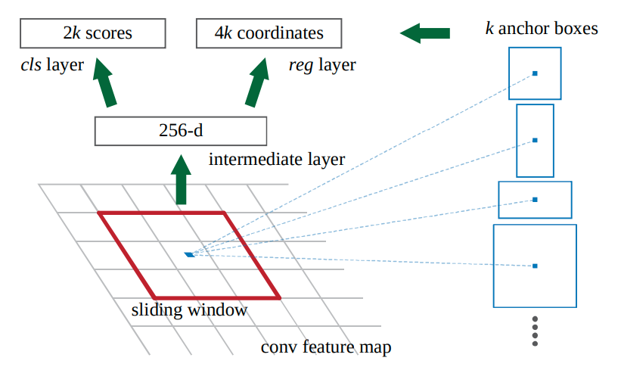
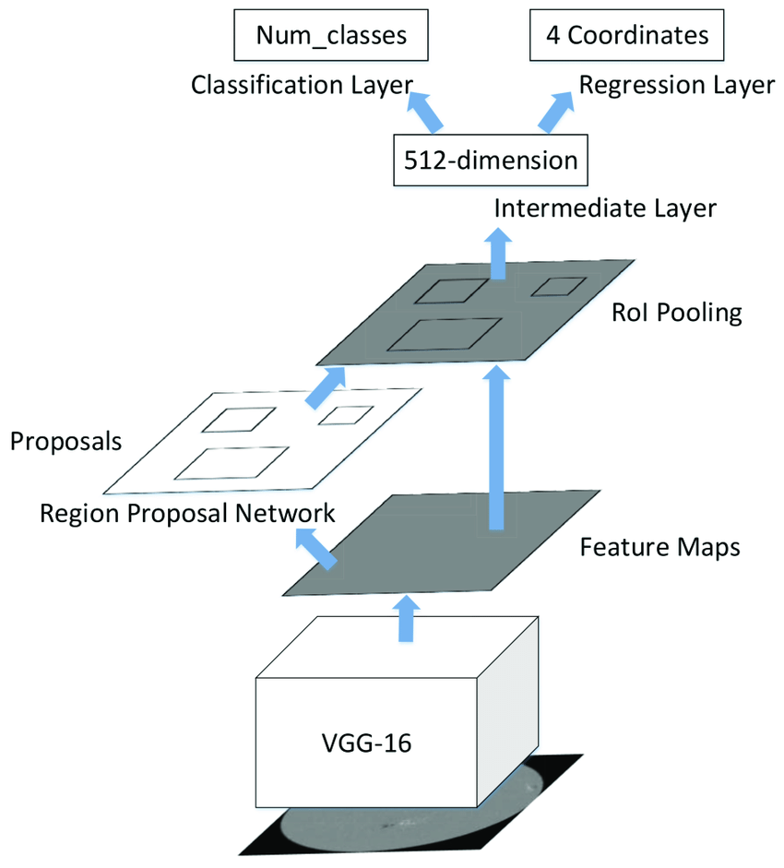
Faster R-CNN
Backbone: Extracts feature maps
RPN: Proposes object regions
ROI Pooling: Extracts fixed-size feature maps
Classification Head: Assign label to proposal
Regressor head: Refine and output bounding boxes
Notes:
Left is the overall arch. Right is the detailed Region Proposal Network (RPN).
Backbone:
Faster R-CNN uses a convolutional neural network (e.g., ResNet or VGG) as a backbone to extract feature maps from the input image.
These feature maps are passed to the Region Proposal Network (RPN).
Region Proposal Network (RPN):
Generates region proposals (potential object locations) based on the feature maps.
Uses anchor boxes to identify regions of interest.
Outputs proposals with objectness scores.
ROI Pooling:
Converts variable-sized region proposals into fixed-size feature maps using ROI Pooling or ROI Align.
Ensures compatibility with fully connected layers for classification and regression.
Fully Connected Layers:
Classification Head: Assigns a class label to each region proposal.
Bounding Box Regressor: Refines the coordinates of the bounding box to align with the detected object.
Output:
Final object detections with class probabilities and bounding box coordinates.

Slide 9
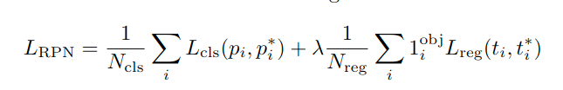
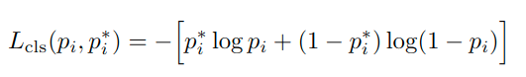
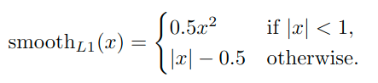
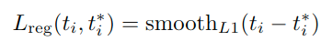
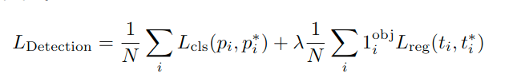
Loss Functions
Notes:
RPN:
Binary classification loss for objectness scores.
Regression loss for anchor box adjustment.
Detection:
Multi-class classification loss for object categories.
Regression loss for bounding box refinement.
Why two?
RPN and detection have different objectives:
RPN focuses on generating accurate region proposals.
Detection focuses on classifying objects and refining proposals.
Using separate losses ensures that each branch is optimized for its specific task while contributing to the overall object detection goal.

Slide 10
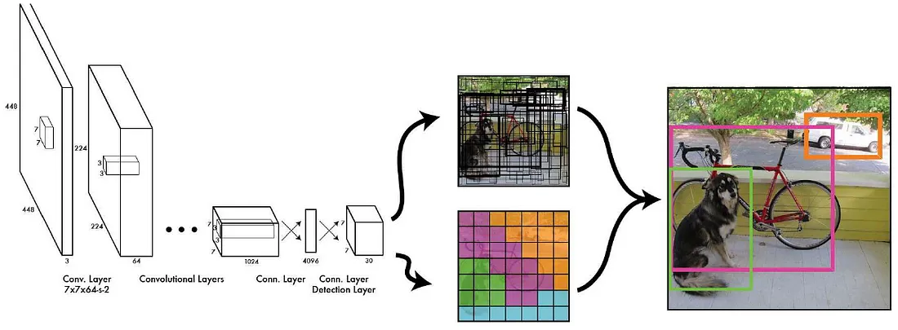
YOLO You Only Look Once
Single-Stage Detector: Combines region proposal and classification
Grid-Based Detection: Divides the image into grids
Bounding Box Prediction: Predicts multiple boxes per grid cell
Notes:
Backbone(extracting features) -> Neck(aggregate feature maps) -> Head(generating the final predictions of the model)
Input and Grid Division:
YOLO divides the input image into an S×SS \times SS×S grid.
Each grid cell is responsible for detecting objects whose center falls within that cell.
Feature Extraction:
Uses a backbone (e.g., Darknet for YOLOv3) to extract features from the input image.
Feature maps are passed to the detection head.
Bounding Box Prediction:
Each grid cell predicts:
Bounding Boxes: Coordinates (x,y,w,h)(x, y, w, h)(x,y,w,h).
Confidence Scores: Probability that a box contains an object.
Class Probabilities: Probability distribution over possible classes.
Non-Maximum Suppression (NMS):
Removes overlapping bounding boxes to keep the most confident predictions.
Output:
Final detections with bounding boxes, confidence scores, and class labels.

Slide 11
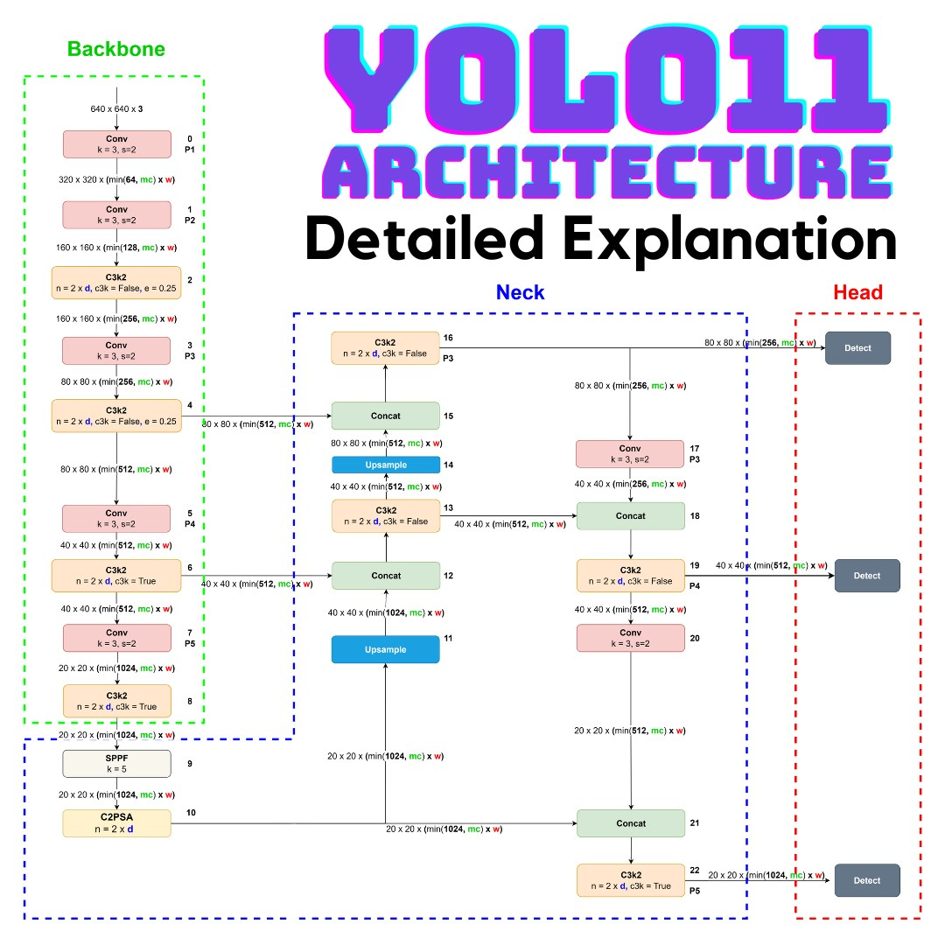
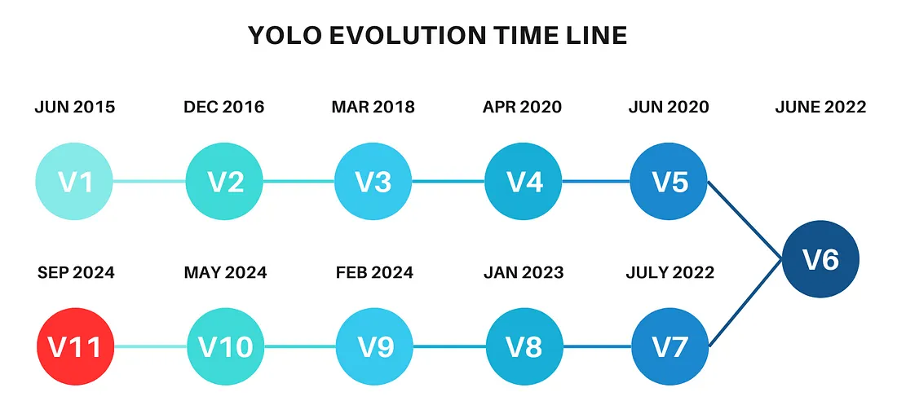
Augment during Training
Backbone: C3k2 Block
Neck: Spatial Attention
Head: Detection Layers at three scales
Notes:
Backbone(extracting features) -> Neck(aggregate feature maps) -> Head(generating the final predictions of the model)
Augmentation: Hue, Saturation, Brightness, rotation etc, help simulate different environmental conditions, lighting variations, and object orientations. (for better generlization)
C3k2 blockCross-Stage Partial: based on the Cross-Stage Partial (CSP) network, consists of two smaller convolutions (kernel size = 2) to reduce the computational cost while retaining performance
Spatial Attention through the C2PSA block, which improves the model’s ability to focus on the most important parts of the image, particularly useful in cluttered scenes with overlapping objects.
Head: employs detection layers at three scales—small (P3), medium (P4), and large (P5)—to detect objects of varying sizes

Slide 12
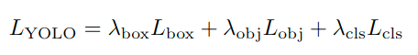
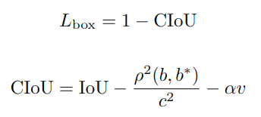
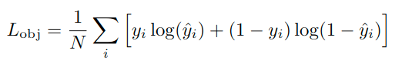
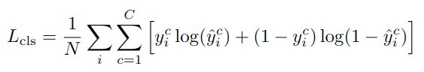
Loss Functions
Notes:
Bounding Box Regression Loss:
Measures how well the predicted bounding boxes match the ground truth.
Focuses on the center coordinates, width, and height of the bounding box.
Objectness (Confidence) Loss:
Determines whether an object exists in a predicted bounding box. (object or background, binary cross entropy)
Classification Loss:
Classifies the detected object into one of the predefined classes. (sumed BCE)
Modern YOLO versions (post-version 8) use improvements such as:
CIoU/DIoU/IoU losses for better bounding box regression.
BCE (Binary Cross Entropy) loss for objectness and classification.

Slide 13
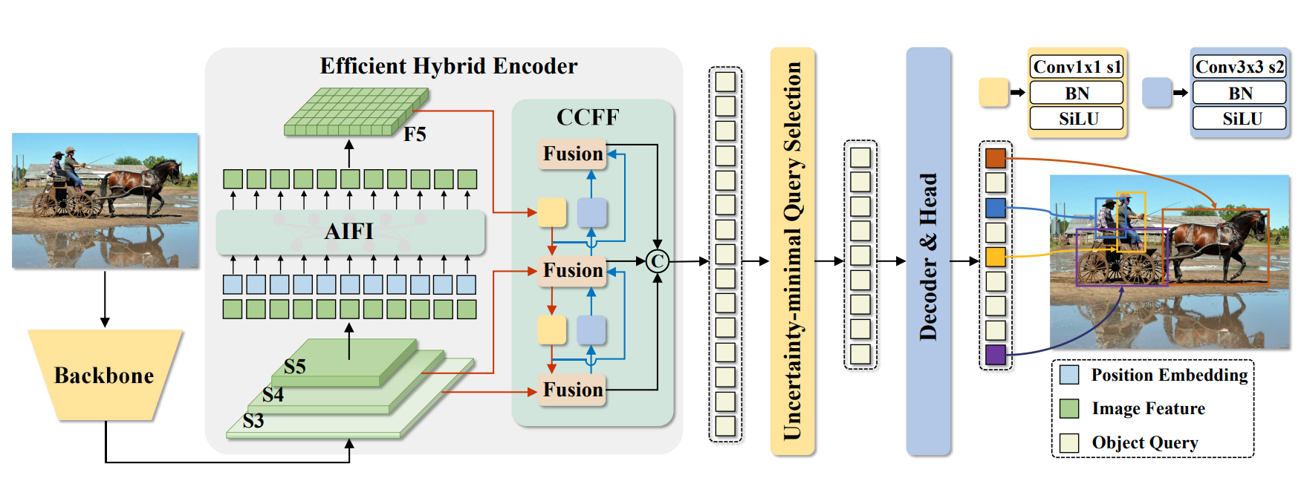
DETR
encoder-decoder structure
Anchor-Free Query-Based Detection
Notes:
BackBone -> Hybrid Encoder -> Query Selection -> Decoder & head
Encoder:
efficient hybrid encoder, consisting of two modules, namely the Attention based Intra-scale Feature Interaction (AIFI) and the CNNbased Cross-scale Feature Fusion (CCFF).
Goal: transforms multi-scale features into a sequence of image features
Query Selection
the uncertainty-minimal query selection selects a fixed number of encoder features to serve as initial object queries for the decoder
Decoder
the decoder with auxiliary prediction heads iteratively optimizes object queries to generate categories and boxes.

Slide 14
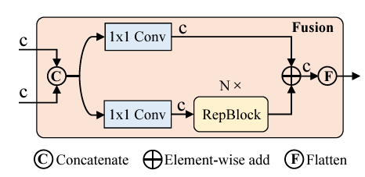
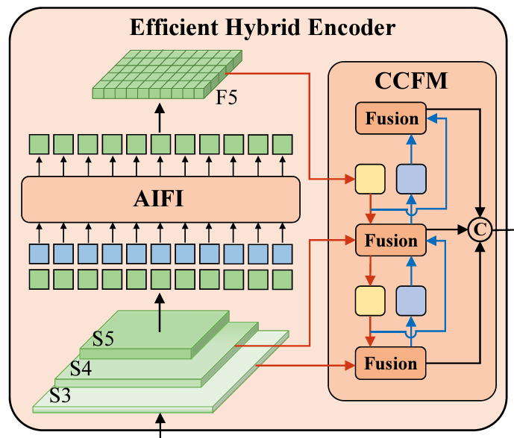
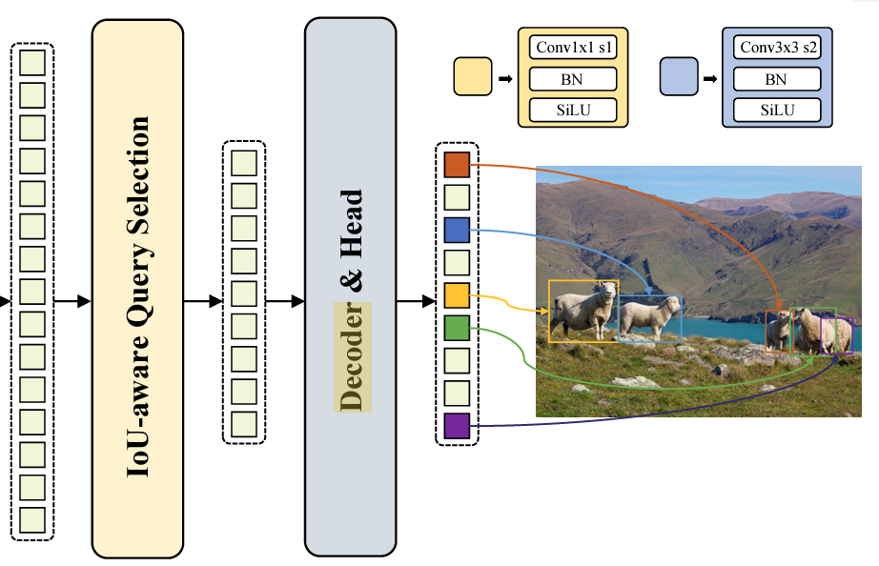
Notes:
Attention based Intra-scale Feature Interaction (AIFI)
Left is the Hybrid Encoder, top right is the detailed the fusion block in CCFF (CNNbased Cross-scale Feature Fusion)
Bottom right is the Query Selection -> Decoder & head

Slide 15
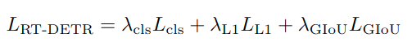
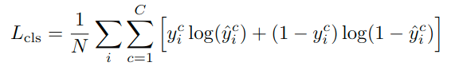
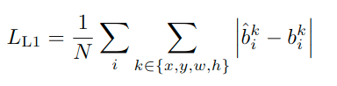
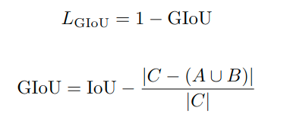
Loss Functions
Notes:
uses Cross-Entropy Loss for multi-class classification
The L1 loss measures the absolute error between the predicted and ground truth bounding box coordinates:
Classification Loss: To classify objects into predefined classes.
Bounding Box Regression Loss: To localize objects using a combination of L1 loss and generalized IoU (GIoU) loss.

Slide 16
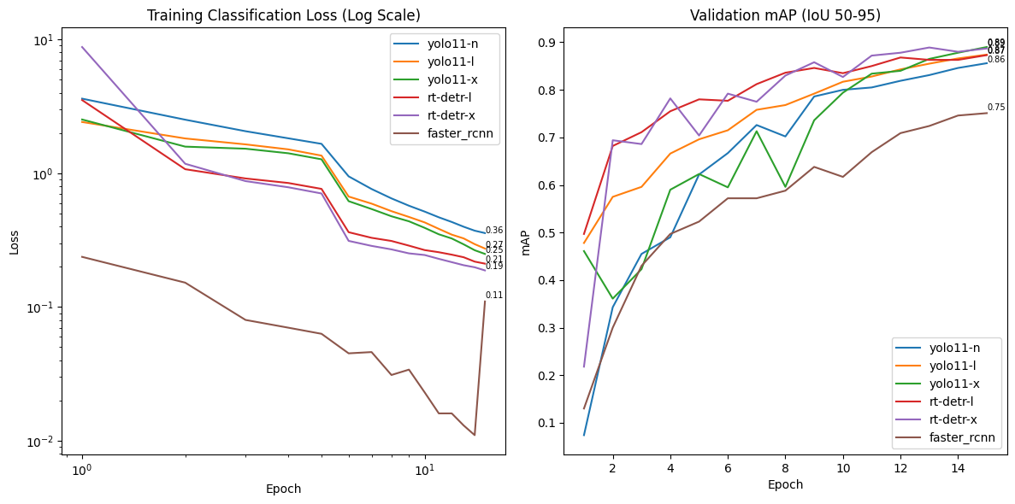
Training Process

Slide 17
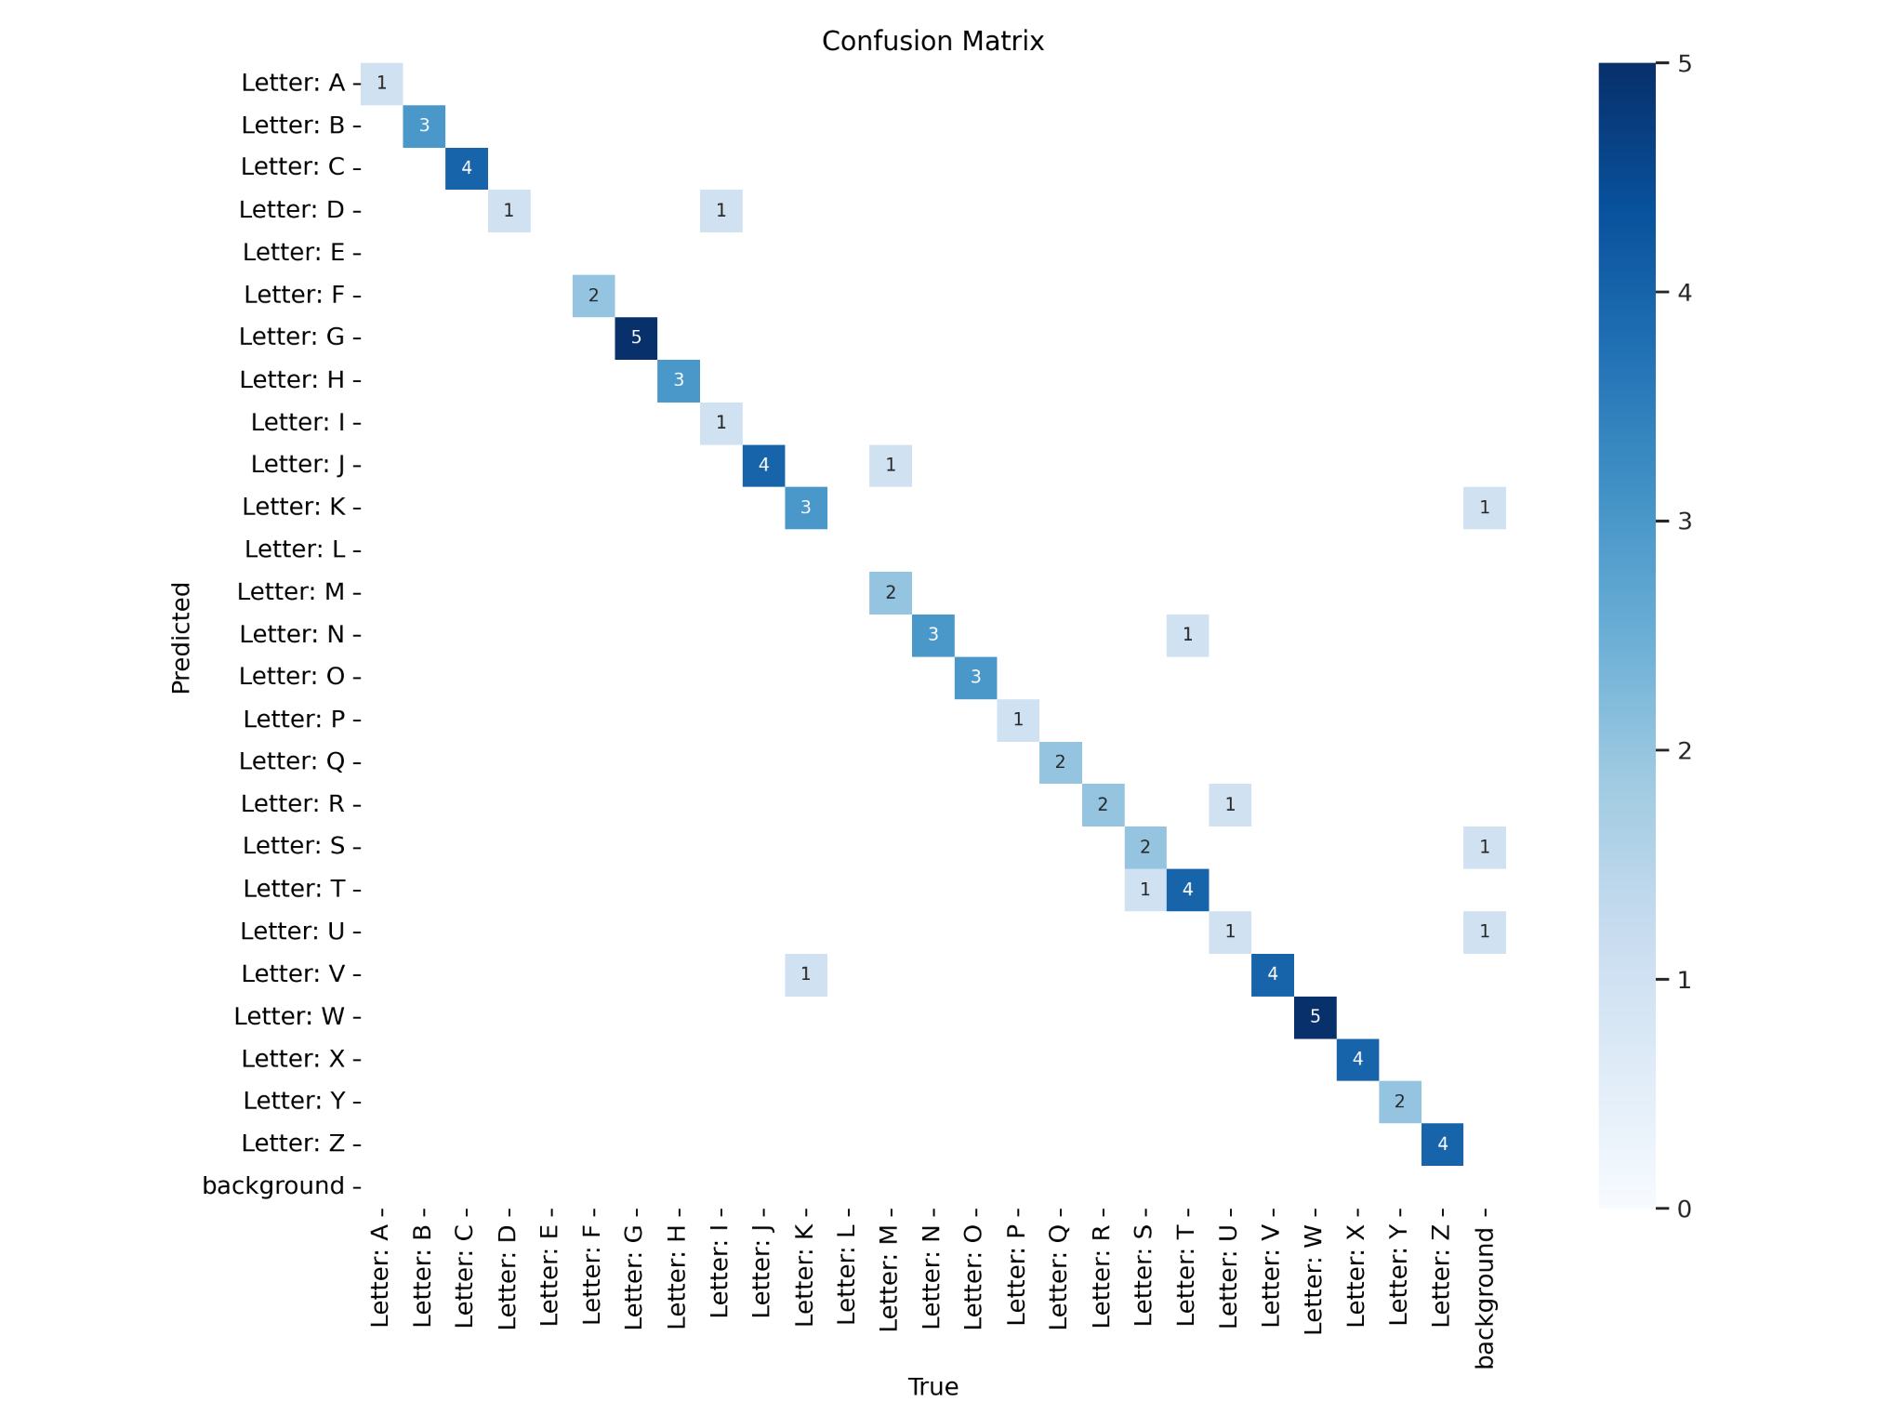
Experiment Result
Model | Latency(ms) | AP 50-95 | # Params(M) | Epoch Training Time(s)
Yolo11-n | 3.32 | 0.692 | 2.5 | 160
Yolo11-l | 7.49 | 0.777 | 25.3 | 170
Yolo11-x | 13.85 | 0.778 | 56.9 | 140
RT-DETR-l | 9.5 | 0.753 | 32.9 | 400
RT-DETR-x | 14.4 | 0.793 | 67.4 | 215
Faster R-CNN | 20.69 | 0.555 | 32.3 | 440
Notes:
Yolo11-n and Yolo11-l, faster RCNN, rt-detr-l can be trained on my laptop 8G GPU
Yolo11-x and RT-DETR-x is trained on a RTX-6000 GPU with 48 G memory.

Slide 18
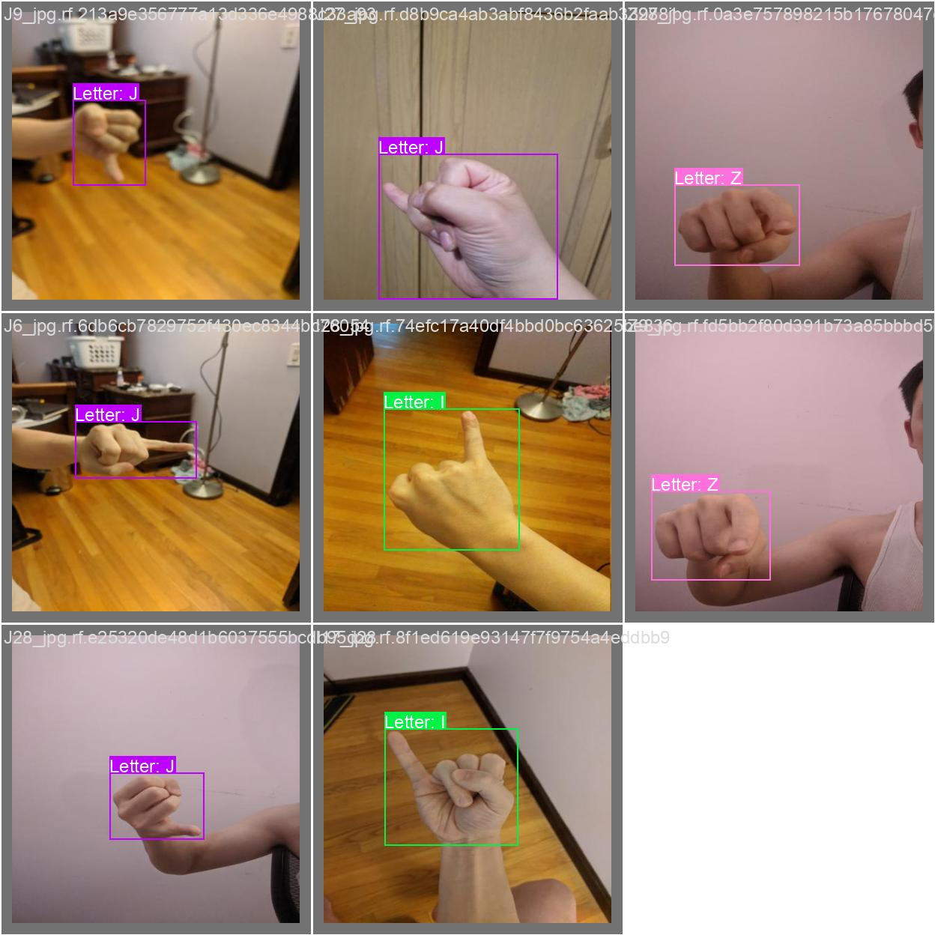



Prediction Examples
Notes:
The left picture grid is the ground truth grid, and the right picture grid is the predictions In this batch, only the picture in the center is misclassified (I to D), at the row 2 col 2 of left grid is a training sample of letter I, and at the row 2 col2 of right grid is a training sample of letter D It might be very easy for us to distinguish them (pointed pinky finger is an I, and pointed index finger is P)
But it seems the model can not distinguish the front and back of our right hand, so it choose letter P as the prediction result, in the model the overall profile mighted weighed to letter P than I (as we can see the confidence level is 0.6 not great too)

Slide 19


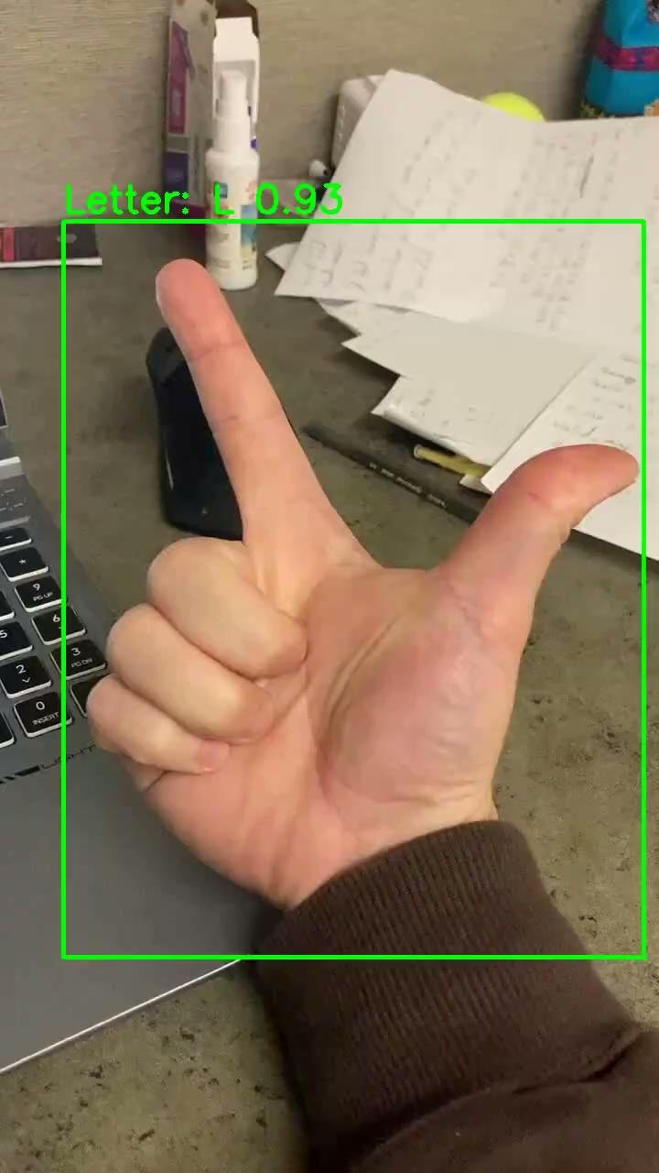
Motion Example
Original Video
Yolo11-n
Yolo11-l

Slide 20
WebCam Example

Slide 21
Reference
https://towardsdatascience.com/what-is-average-precision-in-object-detection-localization-algorithms-and-how-to-calculate-it-3f330efe697b
https://public.roboflow.com/object-detection/american-sign-language-letters/1
https://arxiv.org/pdf/1506.02640 YOLO v1 2015
https://arxiv.org/pdf/2410.22898 YOLO v11 2024
https://arxiv.org/pdf/2304.08069 RT-DETR 2023
https://arxiv.org/pdf/1506.01497v3 faster R-CNN 2015
https://paperswithcode.com/task/object-detection

